Slide 1
Arrays

Slide 2
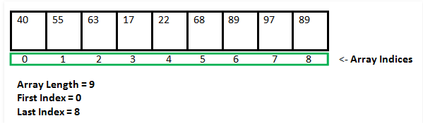
Arrays in C
An array is a variable that can store multiple values.
Array indices start with zero
All arrays consist of contiguous memory locations. The lowest address corresponds to the first element and the highest address to the last element.

Slide 3
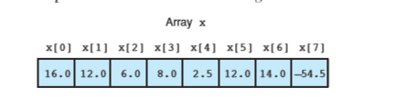
Declaration of Arrays in C
type arrayName [ arraySize ];
Ex. double balance[10];
Initializing Arrays
double x[] = {16.0, 12.0, 6.0, 8.0, 2.5,12.0,14.0,-54.5};
(or)
double x[8] = {16.0, 12.0, 6.0, 8.0,2.5,12.0,14.0,-54.5};

Slide 4
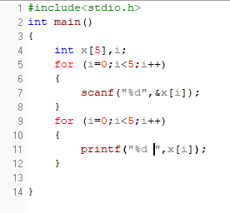
Read array elements from user

Slide 5
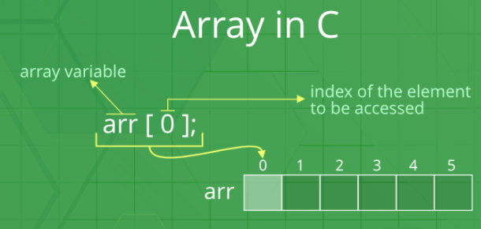
Accessing Array Elements
Array elements are accessed by using an integer index. Array index starts with 0 and goes till size of array minus 1.
There is no index out of bounds checking in C

Slide 6
Examples
Write a Program to find the average of n numbers using arrays.

Slide 7
Multidimensional Arrays
In C programming, you can create an array of arrays. These arrays are known as multidimensional arrays.
Ex. float x[3][4];
Similarly, we can declare a three-dimensional (3d) array.
Ex. float y[2][4][3];

Slide 8

Declaration of 2-D array
two – dimensional array as an array of one – dimensional array.
Syntax:
Ex. int item[3][4], float matrix[4][5]

Slide 9
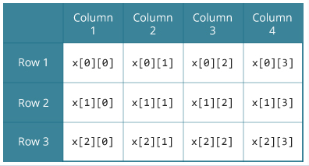
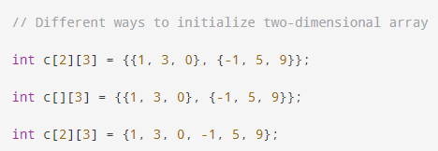
Initialization of a 2d array

Slide 10
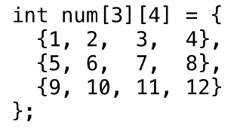
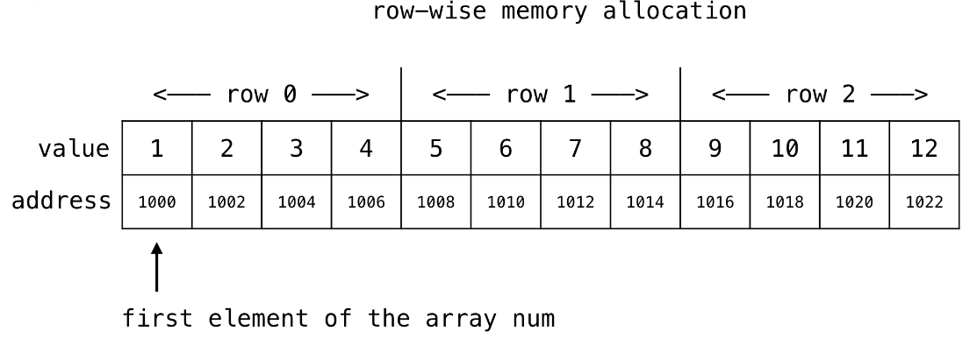
A conceptual representation of 2-D

Slide 11
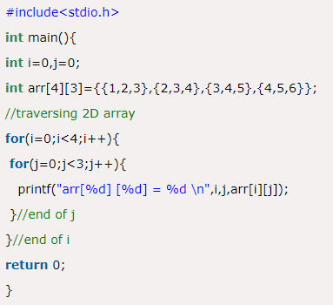
example

Slide 12
Example
Write a c program to calculate Sum of two matrices

Slide 13
3-D Array
A 3D array is essentially an array of arrays of arrays: it's an array or collection of 2D arrays, and a 2D array is an array of 1D array.
Syntax:
int x[2][3][3]

Slide 14
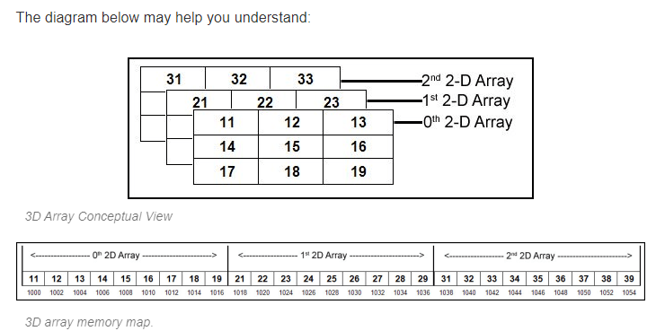
Conceptual view int a[3][3][3]

Slide 15
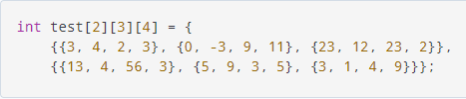
Initialization of a 3d array

Slide 16
